Slide 1
Algorithms
Lecture 7
Graph Traversal and Applications
Prantik Paul [PNP]
Lecturer
Department of Computer Science and Engineering
BRAC University
Adapted From: Slides by Dr. Md Abul Kashem Mia, CSE, BUET

Slide 2
Graph Traversal: We want to visit all nodes

Slide 3
Breadth First Search

Slide 4
Breadth First Search

Slide 5
Breadth First Search

Slide 6
Breadth First Search

Slide 7
Breadth First Search

Slide 8
Depth First Search

Slide 9
Depth First Search

Slide 10
Depth First Search

Slide 11
Depth First Search

Slide 12
Depth First Search

Slide 13
Depth First Search

Slide 14
Depth First Search

Slide 15
Depth First Search

Slide 16
Depth First Search

Slide 17
Depth First Search

Slide 18
Depth First Search

Slide 19
Depth First Search

Slide 20
Depth First Search

Slide 21
Depth First Search

Slide 22
Depth First Search

Slide 23
Depth First Search

Slide 24
Depth First Search

Slide 25
Breadth-First Search: Colors
White vertices - Unvisited
Grey vertices - Visited but not fully explored
Black vertices - Visited and fully explored

Slide 26
Properties of Vertex
class Vertex:
def __init__(self, key):
self.key = key
self.color = 'WHITE'
self.d = float('inf')
self.p = None
1
a
DHK
0
1
2
We store the parent node here. For example, the parent of 2 is 1. So for the node of 2, we will store the node of 1 here

Slide 27
Breadth-First Search
BFS(G, s) {
initialize vertices;
Q = {s}; // Q is a queue (duh); initialize to s
while (Q not empty) {
u = RemoveTop(Q);
for each v ∈ u->adj {
if (v->color == WHITE)
v->color = GREY;
v->d = u->d + 1;
v->p = u;
Enqueue(Q, v);
}
u->color = BLACK;
}
}
What does v->d represent?
What does v->p represent?

Slide 28
Breadth-First Search: Example
r
s
t
u
∞
∞
∞
∞
∞
∞
∞
∞
v
w
x
y

Slide 29
Breadth-First Search: Example
r
s
t
u
∞
0
∞
∞
∞
∞
∞
∞
v
w
x
y
Q:
s

Slide 30
Breadth-First Search: Example
r
s
t
u
∞
0
∞
∞
∞
1
∞
∞
v
w
x
y
Q:
w

Slide 31
Breadth-First Search: Example
r
s
t
u
1
0
∞
∞
∞
1
∞
∞
v
w
x
y
Q:
w
r

Slide 32
Breadth-First Search: Example
r
s
t
u
1
0
∞
∞
∞
1
∞
∞
v
w
x
y
Q:
w
r

Slide 33
Breadth-First Search: Example
r
s
t
u
1
0
2
∞
∞
1
2
∞
v
w
x
y
Q:
r
t
x

Slide 34
Breadth-First Search: Example
r
s
t
u
1
0
2
∞
2
1
2
∞
v
w
x
y
Q:
t
x
v

Slide 35
Breadth-First Search: Example
r
s
t
u
1
0
2
3
2
1
2
∞
v
w
x
y
Q:
x
v
u

Slide 36
Breadth-First Search: Example
r
s
t
u
1
0
2
3
2
1
2
3
v
w
x
y
Q:
v
u
y

Slide 37
Breadth-First Search: Example
r
s
t
u
1
0
2
3
2
1
2
3
v
w
x
y
Q:
u
y

Slide 38
Breadth-First Search: Example
r
s
t
u
1
0
2
3
2
1
2
3
v
w
x
y
Q:
y

Slide 39
Breadth-First Search: Example
r
s
t
u
1
0
2
3
2
1
2
3
v
w
x
y
Q:
Ø

Slide 40
BFS: The Code Again
BFS(G, s) {
initialize vertices;
Q = {s};
while (Q not empty) {
u = RemoveTop(Q);
for each v ∈ u->adj {
if (v->color == WHITE)
v->color = GREY;
v->d = u->d + 1;
v->p = u;
Enqueue(Q, v);
}
u->color = BLACK;
}
}

Slide 41
BFS: The Code Again
BFS(G, s) {
initialize vertices;
Q = {s};
while (Q not empty) {
u = RemoveTop(Q);
for each v ∈ u->adj {
if (v->color == WHITE)
v->color = GREY;
v->d = u->d + 1;
v->p = u;
Enqueue(Q, v);
}
u->color = BLACK;
}
}
Touch every vertex: O(V)
u = every vertex, but only once
So v = every vertex that appears in some other vert’s adjacency list
What will be the running time?
Total running time: O(V+E)

Slide 42
Finding Shortest Path Using BFS
We are storing the parent of all nodes, right?
For finding shortest path between u and v, just start from v and backtrack using the parent of each node until you reach u!

Slide 43
Finding Shortest Path Using BFS
r
s
t
u
1
0
2
3
2
1
2
3
v
w
x
y
Question: Find shortest path between (s,y)

Slide 44
Finding Shortest Path Using BFS
One possible path
r
s
t
u
1
0
2
3
2
1
2
3
v
w
x
y
Question: Find shortest path between (s,y)

Slide 45
Finding Shortest Path Using BFS
Another possible path
r
s
t
u
1
0
2
3
2
1
2
3
v
w
x
y
Question: Find shortest path between (s,y)

Slide 46
Finding Shortest Path Using BFS
Another possible path
r
s
t
u
1
0
2
3
2
1
2
3
v
w
x
y
Question: Find shortest path between (s,y)

Slide 47
Finding Shortest Path Using BFS
r
s
t
u
1
0
2
3
2
1
2
3
v
w
x
y
Start from y

Slide 48
Finding Shortest Path Using BFS
r
s
t
u
1
0
2
3
2
1
2
3
v
w
x
y
Parent of y -> x

Slide 49
Finding Shortest Path Using BFS
r
s
t
u
1
0
2
3
2
1
2
3
v
w
x
y
Parent of x -> w

Slide 50
Finding Shortest Path Using BFS
r
s
t
u
1
0
2
3
2
1
2
3
v
w
x
y
Parent of w -> s

Slide 51
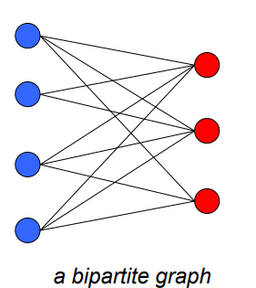
Bipartite Graphs
No adjacent vertices have the same color

Slide 52
Bipartite Graphs
No adjacent vertices have the same color

Slide 53
Bipartite Graphs
No adjacent vertices have the same color
Ok
Not Ok

Slide 54
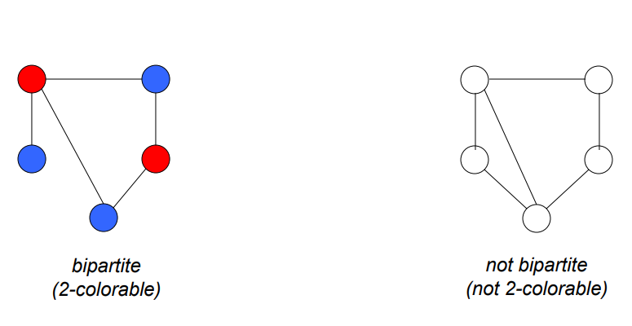
Bipartite Graphs

Slide 55
Detecting Bipartite Graphs with BFS
r
s
t
u
∞
∞
∞
∞
∞
∞
∞
∞
v
w
x
y

Slide 56
Detecting Bipartite Graphs with BFS
r
s
t
u
∞
∞
∞
∞
∞
∞
∞
∞
v
w
x
y

Slide 57
Detecting Bipartite Graphs with BFS
r
s
t
u
∞
∞
∞
∞
∞
∞
∞
∞
v
w
x
y

Slide 58
Detecting Bipartite Graphs with BFS
r
s
t
u
∞
∞
∞
∞
∞
∞
∞
∞
v
w
x
y

Slide 59
Detecting Bipartite Graphs with BFS
r
s
t
u
∞
∞
∞
∞
∞
∞
∞
∞
v
w
x
y

Slide 60
Detecting Bipartite Graphs with BFS
r
s
t
u
∞
∞
∞
∞
∞
∞
∞
∞
v
w
x
y

Slide 61
Detecting Bipartite Graphs with BFS
r
s
t
u
∞
∞
∞
∞
∞
∞
∞
∞
v
w
x
y
Same colored vertex encountered!
Not bipartite

Slide 62
Detecting Bipartite Graphs with BFS
BipartiteBicolorableBFS(G, s):
for each vertex u in G.V:
u.color = NIL
s.color = 0
Q = new Queue()
Q.enqueue(s)
while Q is not empty:
u = Q.dequeue()
for each v in G.Adj[u]:
if v.color == NIL:
v.color = 1 - u.color
Q.enqueue(v)
else if v.color == u.color:
return False
return True

Slide 63
Detecting Odd Cycles in Graphs with BFS
r
s
t
u
∞
∞
∞
∞
∞
∞
∞
∞
v
w
x
y
Same colored vertex encountered!
Not bipartite, odd length cycle

Slide 64
Detecting Odd Cycles in Graphs with BFS
bipartite, even length cycle
bipartite, no cycle

Slide 65
Depth-First Search
Depth-first search is another strategy for exploring a graph
Explore “deeper” in the graph whenever possible
Edges are explored out of the most recently discovered vertex v that still has unexplored edges
When all of v’s edges have been explored, backtrack to the vertex from which v was discovered

Slide 66
Depth-First Search
Vertices initially colored white
Then colored gray when discovered
Then black when finished

Slide 67
Depth-First Search: The Code
DFS(G)
{
for each vertex u ∈ G->V
{
u->color = WHITE;
}
time = 0;
for each vertex u ∈ G->V
{
if (u->color == WHITE)
DFS_Visit(u);
}
}
DFS_Visit(u)
{
u->color = GREY;
time = time+1;
u->d = time;
for each v ∈ u->Adj[]
{
if (v->color == WHITE)
DFS_Visit(v);
}
u->color = BLACK;
time = time+1;
u->f = time;
}

Slide 68
Depth-First Search: The Code
DFS(G)
{
for each vertex u ∈ G->V
{
u->color = WHITE;
}
time = 0;
for each vertex u ∈ G->V
{
if (u->color == WHITE)
DFS_Visit(u);
}
}
DFS_Visit(u)
{
u->color = GREY;
time = time+1;
u->d = time;
for each v ∈ u->Adj[]
{
if (v->color == WHITE)
DFS_Visit(v);
}
u->color = BLACK;
time = time+1;
u->f = time;
}
What does u->d represent?

Slide 69
Depth-First Search: The Code
DFS(G)
{
for each vertex u ∈ G->V
{
u->color = WHITE;
}
time = 0;
for each vertex u ∈ G->V
{
if (u->color == WHITE)
DFS_Visit(u);
}
}
DFS_Visit(u)
{
u->color = GREY;
time = time+1;
u->d = time;
for each v ∈ u->Adj[]
{
if (v->color == WHITE)
DFS_Visit(v);
}
u->color = BLACK;
time = time+1;
u->f = time;
}
What does u->f represent?

Slide 70
Depth-First Search: The Code
DFS(G)
{
for each vertex u ∈ G->V
{
u->color = WHITE;
}
time = 0;
for each vertex u ∈ G->V
{
if (u->color == WHITE)
DFS_Visit(u);
}
}
DFS_Visit(u)
{
u->color = GREY;
time = time+1;
u->d = time;
for each v ∈ u->Adj[]
{
if (v->color == WHITE)
DFS_Visit(v);
}
u->color = BLACK;
time = time+1;
u->f = time;
}
discovery time u->d and finishing time u->f

Slide 71
Depth-First Search: The Code
DFS(G)
{
for each vertex u ∈ G->V
{
u->color = WHITE;
}
time = 0;
for each vertex u ∈ G->V
{
if (u->color == WHITE)
DFS_Visit(u);
}
}
DFS_Visit(u)
{
u->color = GREY;
time = time+1;
u->d = time;
for each v ∈ u->Adj[]
{
if (v->color == WHITE)
DFS_Visit(v);
}
u->color = BLACK;
time = time+1;
u->f = time;
}
Running time of DFS = O(V+E)

Slide 72
DFS Example
source vertex

Slide 73
DFS Example
source vertex
d f
1 |
|
|
|
|
|
|
|

Slide 74
DFS Example
source vertex
d f
1 |
|
|
2 |
|
|
|
|

Slide 75
DFS Example
source vertex
d f
1 |
|
|
2 |
|
3 |
|
|

Slide 76
DFS Example
source vertex
d f
1 |
|
|
2 |
|
3 | 4
|
|

Slide 77
DFS Example
source vertex
d f
1 |
|
|
2 |
|
3 | 4
5 |
|

Slide 78
DFS Example
source vertex
d f
1 |
|
|
2 |
|
3 | 4
5 | 6
|

Slide 79
DFS Example
source vertex
d f
1 |
8 |
|
2 | 7
|
3 | 4
5 | 6
|

Slide 80
DFS Example
source vertex
d f
1 |
8 |
|
2 | 7
9 |
3 | 4
5 | 6
|
What is the structure of the grey vertices? What do they represent?

Slide 81
DFS Example
source vertex
d f
1 |
8 |
|
2 | 7
9 |10
3 | 4
5 | 6
|

Slide 82
DFS Example
source vertex
d f
1 |
8 |11
|
2 | 7
9 |10
3 | 4
5 | 6
|

Slide 83
DFS Example
source vertex
d f
1 |12
8 |11
|
2 | 7
9 |10
3 | 4
5 | 6
|

Slide 84
DFS Example
source vertex
d f
1 |12
8 |11
13|
2 | 7
9 |10
3 | 4
5 | 6
|

Slide 85
DFS Example
source vertex
d f
1 |12
8 |11
13|
2 | 7
9 |10
3 | 4
5 | 6
14|

Slide 86
DFS Example
source vertex
d f
1 |12
8 |11
13|
2 | 7
9 |10
3 | 4
5 | 6
14|15

Slide 87
DFS Example
source vertex
d f
1 |12
8 |11
13|16
2 | 7
9 |10
3 | 4
5 | 6
14|15

Slide 88
DFS: Kinds of edges
DFS introduces an important distinction among edges in the original graph:
Tree edge: encounter WHITE vertex
Back edge: encounter GREY vertex
Cross edge: encounter BLACK vertex

Slide 89
CLASSIFYING EDGES OF A DIGRAPH
Edge (u, v) is:
Tree edge – if v is white
Back edge – if v is gray
Forward or cross - if v is black
Forward edge – if v is black and d[u] < d[v]
(v was discovered after u)
Cross edge – if v is black and d[u] > d[v]
(u discovered after v)

Slide 90
Depth First Search

Slide 91
Depth First Search
Tree Edges

Slide 92
Depth First Search
Tree Edges

Slide 93
Depth First Search
Suppose if there was an edge like this
Tree Edges
Back Edges

Slide 94
Depth First Search
Tree Edges
Back Edges

Slide 95
Depth First Search
Tree Edges
Back Edges
Cross Edges
Suppose if there was an edge like this

Slide 96
Depth First Search
Tree Edges
Back Edges
Cross Edges

Slide 97
Depth First Search
Tree Edges
Back Edges
Cross Edges

Slide 98
Depth First Search
Tree Edges
Back Edges
Cross Edges

Slide 99
Depth First Search
Tree Edges
Back Edges
Cross Edges

Slide 100
Depth First Search
Tree Edges
Back Edges
Cross Edges

Slide 101
Depth First Search
Tree Edges
Back Edges
Cross Edges

Slide 102
Depth First Search
Tree Edges
Back Edges
Cross Edges

Slide 103
Depth First Search
Tree Edges
Back Edges
Cross Edges

Slide 104
Depth First Search
Tree Edges
Back Edges
Cross Edges

Slide 105
Depth First Search
Tree Edges
Back Edges
Cross Edges

Slide 106
Depth First Search
Tree Edges
Back Edges
Cross Edges
Forward Edges
What if there was another edge here?

Slide 107
Depth First Search
Tree Edges
Back Edges
Cross Edges
Forward Edges

Slide 108
DFS Example
source vertex
d f
1 |12
8 |11
13|16
2 | 7
9 |10
3 | 4
5 | 6
14|15
Tree edges

Slide 109
DFS Example
source vertex
d f
1 |12
8 |11
13|16
2 | 7
9 |10
3 | 4
5 | 6
14|15
Tree edges
Back edges

Slide 110
DFS Example
source vertex
d f
1 |12
8 |11
13|16
2 | 7
9 |10
3 | 4
5 | 6
14|15
Tree edges
Back edges
Forward edges

Slide 111
DFS Example
source vertex
d f
1 |12
8 |11
13|16
2 | 7
9 |10
3 | 4
5 | 6
14|15
Tree edges
Back edges
Forward edges
Cross edges

Slide 112
Detecting Cycles In a Graph Using DFS
While running DFS, encountering a back edge implies a cycle
Back Edges -> Encountering GREY vertex

Slide 113
DFS And Cycles
How would you modify the code to detect cycles?
DFS(G)
{
for each vertex u ∈ G->V
{
u->color = WHITE;
}
time = 0;
for each vertex u ∈ G->V
{
if (u->color == WHITE)
DFS_Visit(u);
}
}
DFS_Visit(u)
{
u->color = GREY;
time = time+1;
u->d = time;
for each v ∈ u->Adj[]
{
if (v->color == WHITE)
DFS_Visit(v);
}
u->color = BLACK;
time = time+1;
u->f = time;
}

Slide 114
DFS And Cycles
DFS(G)
{
for each vertex u ∈ G->V
{
u->color = WHITE;
}
time = 0;
for each vertex u ∈ G->V
{
if (u->color == WHITE)
DFS_Visit(u);
}
}
DFS_Visit(u)
{
u->color = GREY;
time = time+1;
u->d = time;
for each v ∈ u->Adj[]
{
if (v->color == WHITE)
DFS_Visit(v);
if (v->color == GREY)
print(“cycle found!”)
}
u->color = BLACK;
time = time+1;
u->f = time;
}

Slide 115
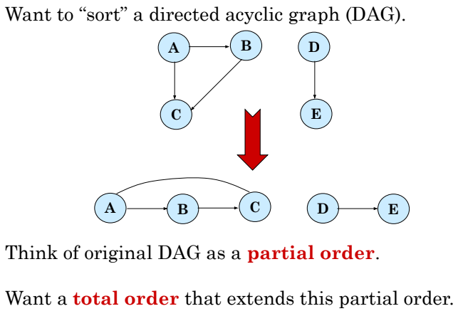
TOPOLOGICAL SORT

Slide 116
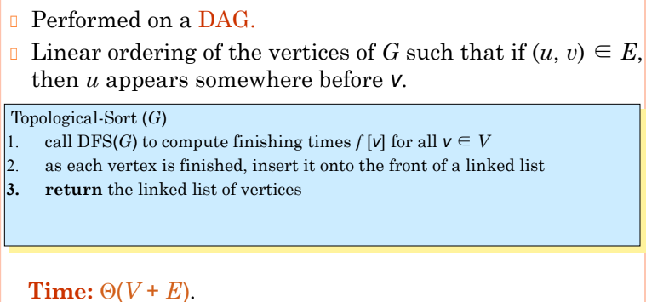
TOPOLOGICAL SORT

Slide 117
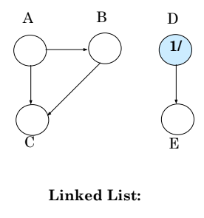
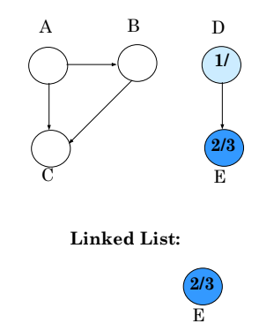
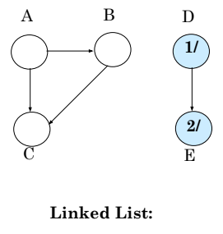
TOPOLOGICAL SORT
Example

Slide 118
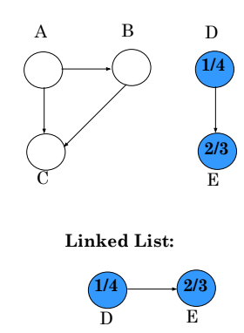
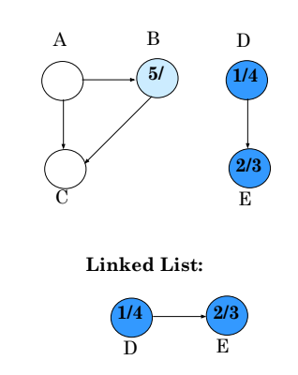
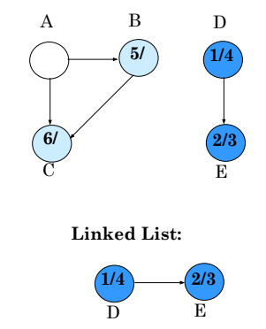
TOPOLOGICAL SORT
Example

Slide 119
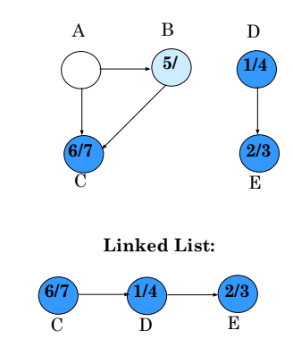
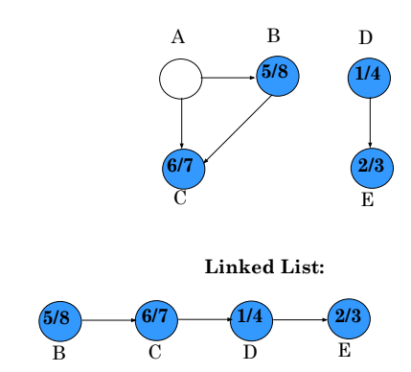
TOPOLOGICAL SORT
Example

Slide 120
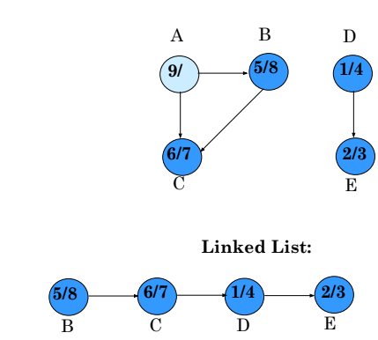
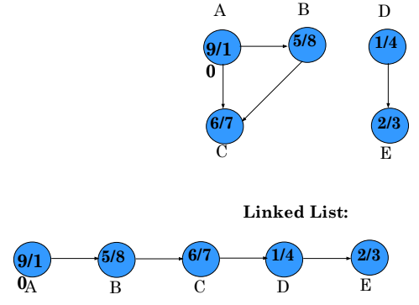
TOPOLOGICAL SORT
Example

Slide 121
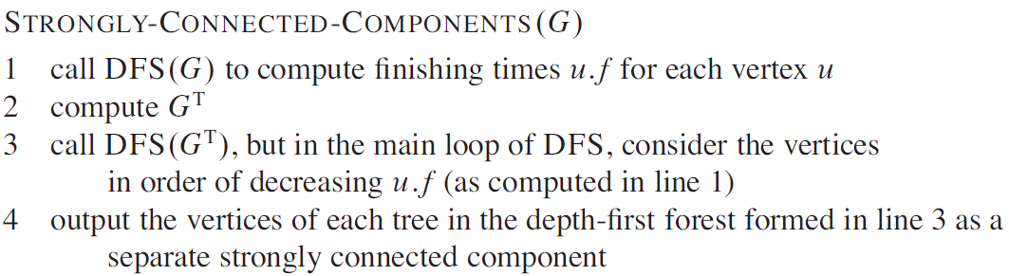
Strongly Connected Component

Slide 122
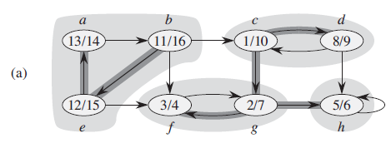
Strongly Connected Component
(a) A directed graph G. Each shaded region is a strongly connected component of G. Each vertex is labeled with its discovery and finishing times in a depth-first search, and tree edges are shaded.

Slide 123
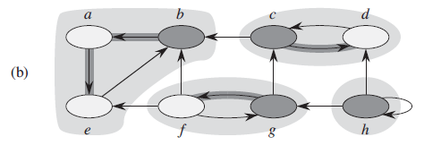
Strongly Connected Component
(b) The graph G^{T,} the transpose of G, with the depth-first forest computed in line 3 of STRONGLY-CONNECTED-COMPONENTS shown and tree edges shaded. Each strongly connected component corresponds to one depth-first tree. Vertices b, c, g, and h, which are heavily shaded, are the roots of the depth-first trees produced by the depth-first search of G^{T}.

Slide 124
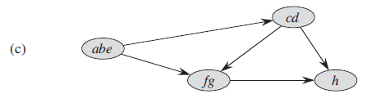
Strongly Connected Component
(c) The acyclic component graph G^{SCC} obtained by contracting all edges within each strongly connected component of G so that only a single vertex remains in each component.

Slide 125
Extra Materials
The algorithm of finding strongly connected components using Depth First Search
CLRS book page 615
Topological Sorting
CLRS book page 612
See the “Problems related to BFS section”
Breadth First Search or BFS for a Graph - GeeksforGeeks
For DFS, go through this link:
Applications, Advantages and Disadvantages of Depth First Search (DFS) - GeeksforGeeks
Practice solving problems by coding

